Slide 1
Different ‘bar graphs’
Select bar, count(*), avg(price) from sells
group by bar;
Select drinker, count(*) from likes
group by drinker;
Select beer, count(*) as c from sells
Group by beer
Order by c desc
1

Slide 2
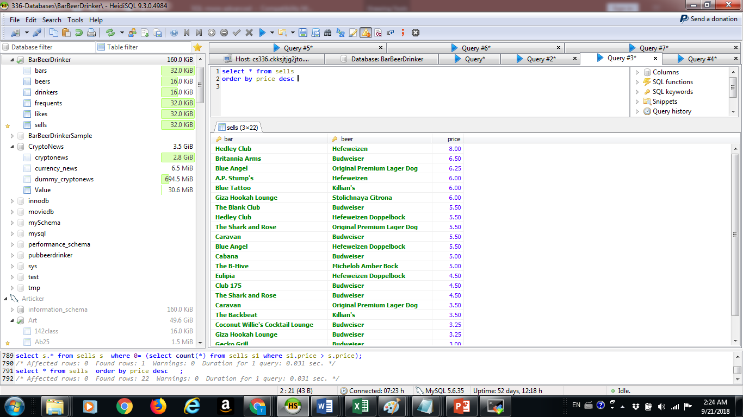
Beers ordered by price

Slide 3
Most expensive beer
select sells.beer from sells
order by price desc
limit 1
* Works only if there are no “ties”

Slide 4
Most expensive with ties
select s.beer, s.price from sells s
where 0= (select count(*) from sells s1 where s1.price > s.price)

Slide 5
Tied for 4th most expensive
select s.beer, s.price from sells s
where 3= (select count(*) from sells s1 where s1.price > s.price)

Slide 6
Tied for 6th
select s.beer, s.price from sells s
where 6= (select count(*) from sells s1 where s1.price > s.price)

Slide 7
Least expensive
select s.beer, s.price from sells s
where 0= (select count(*) from sells s1 where s1.price < s.price)

Slide 8
select bar, count(*) as beernumber from sells
group by bar
having beernumber <3

Slide 9
select s.* from sells s
where s.beer='Budweiser' and 0= (select count(*) from sells s1 where s1.price > s.price and s1.beer='Budweiser')

Slide 10
select * from sells s
where s.bar ='Blue Angel' and 0= (select count(*) from sells s1 where s1.bar=s.bar and s1.price >s.price)

Slide 11
select s.bar, l.drinker, count(*) as c from sells s, likes l
where s.beer=l.beer and l.drinker='Mike'
group by s.bar, l.drinker
order by c desc

Slide 12
Nonmonotone –’only’
select l.drinker, l.beer, count(*) from likes l
Where l.beer='Original Premium'
group by l.drinker, l.beer
having count(*) =1

Slide 13
But what if I just wanted the drinker who like only ‘Original Premium’
select T.drinker from (select l.drinker, l.beer, count(*) as number from likes l
Where l.beer='Original Premium'
group by l.drinker, l.beer
having count(*) =1)T

Slide 14
Drinkers who like all beers
select drinker, count(*) as c from likes
group by drinker
having c = (select count(*) from beers)

Slide 15
Beer with median price
select s.beer, s.price from sells s
where (select count(*) from sells s1 where s1.price >s.price) =(select count(*) from sells s1 where s1.price < s.price)

Slide 16
NULLS
Three valued semantics
(NULL=constant) not True
(NULL<> constant) not True
Also no NULL is equal to a NULL
So Nulls are ignored by SQL

Slide 17
Can’t handle the truth!
Select beer from sells
where price >5 or price <=5
Should return all beers – but if price=NULL, this beer will not be returned!

Slide 18
IS NULL
Different semantics
If value is in fact ‘NULL’
Used in outer joins

